Slide 1







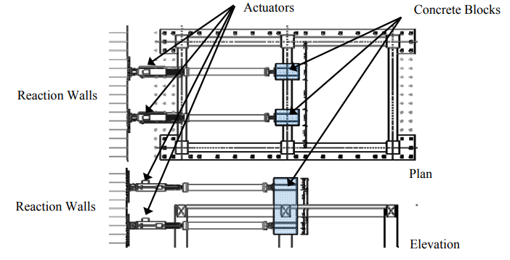
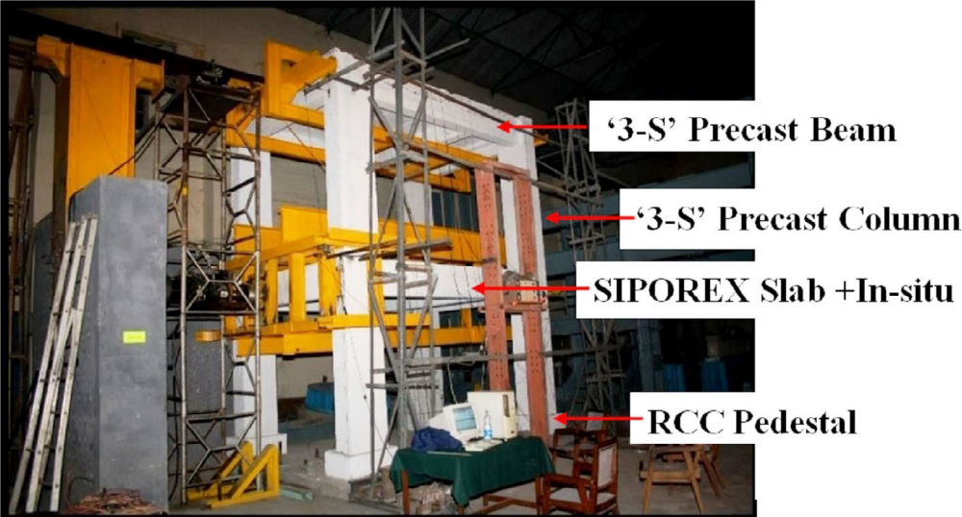
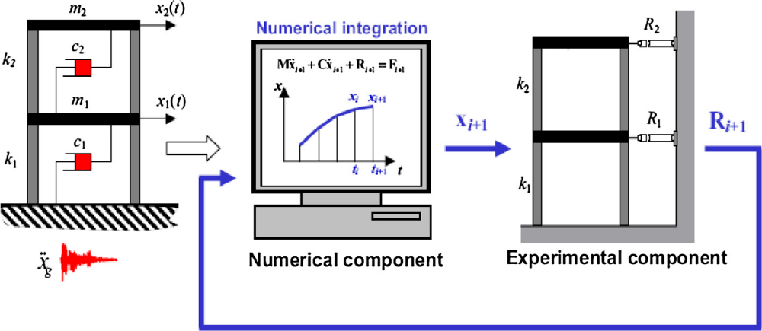
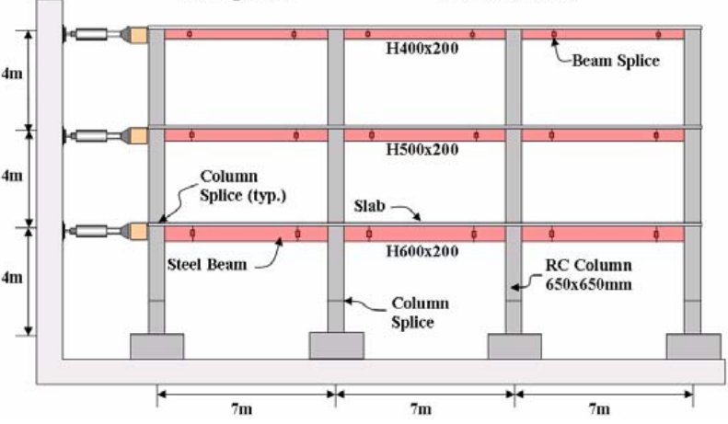
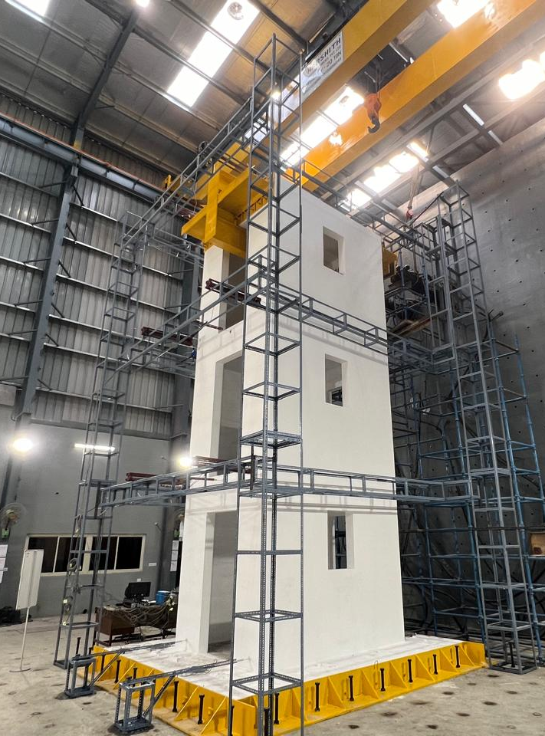
Full-scale Structural Performance Evaluation: State-of-the-Art Test Methods
Ajay Chourasia^{*1, 2}, Alpana Chauhan¹, Moka Eswar^{1, 2}
¹ CSIR - Central Building Research Institute, Roorkee 247667, India
² Academy of Scientific and Innovative Research (AcSIR), Ghaziabad 201002, India
Email: ajayc@cbri.res.in
`
4th International Symposium on
One Health, One World
20th-22nd November, 2025
CSIR-CBRI, Roorkee, India
Objective
In the recent years, there is a paradigm shift in research interest to investigate the response of buildings from component-level to system-level, preferably ……….
……..
Static
Load is applied steadily to structure until failure
…….….
Static and Quasi-static Test Setup^{[1, 2]}
Quasi-static
Simulates seismic conditions by applying cyclic….
….
…
Work Plan/ Experimental
Simulates seismic conditions by applying cyclic….
….
…
Schematic of Pseudo-dynamic Test Method^{[3]}
Pseudo-dynamic
Shake table
Simulates seismic conditions by applying cyclic….
….
…
Numerical component
Experimental component
Measured actuator displacements
Results/Analysis
Experimental Structure
ATS COMPENSATOR
Multiple servo-hydraulic actuators connected to an experimental substructure, actuator out 0.12 mm displacement, highlighting the need for compensation measures………..
…………………
………………….
ACTUATORS
Impose actuator displacements
Innovation
Research Significance
The ASTM E2126 standard is one of the ….
Accurately simulating boundary conditions in full-scale testing is a significant ………………
…………..
………..
…..
…………………
…………………….
Conclusion
Preliminary tests with predefined inputs is necessary to understand the ………………………..
………………………………………
………………………….
………………………………………
Limitation of test facilities for full scale testing of structures using shake table or
…………..
………………………..
…………………………..
…………………………………
References
T. Kabeyasawa, T. Mukai, H. Fukuyama, et al (2017) Full Scale Static Loading Test on a Five Story Reinforced Concrete Building (Part2: Damage Analysis). 16th World Conf Earthq Eng
A. Chourasia, Y. Kajale, S. Singhal, J. Parashar (2020) Seismic performance assessment of two‐storey precast reinforced concrete building. Structural Concrete 21:2011–2027. https://doi.org/10.1002/suco.201900146
J. E. Carrion, B. F. Spencer (2007) Model-based Strategies for Real-time Hybrid Testing. Newmark Structural Engineering Lab. NSEL Report Series Report No. NSEL-006.
Acknowledgements:
The authors thank the Director of CSIR – Central Building Research Institute, Roorkee for granting permission to publish this work.
www.ohow2025.in

Slide 2
`
Poster Guidelines
Guidelines for the poster preparation:
Please bring the poster in a color print in A1 size.
Refer to the model template given in the first slide of this presentation.
Maintain the slide size, and fonts [Book Antiqua, font size between 25 to 35 for figures, and contents (Eg: Figure) and 50 to 55 for titles (Eg: Objective)] as mentioned in the model template.
The title of the research/study is a template by itself and should be edited with the same font size and style. Use the current affiliations of the authors as mentioned in the extended abstracts/papers submitted.
Use high-quality images, graphs, and charts (PNG format) in the poster with the proper figure citations explaining them.
Maintain a proper flow among the topics with the objective of the study and the conclusion being mandatory in the poster.
Split the poster into segments to improve readability.
Do not overcrowd the poster with information. Use bullets to list the contents.
The referencing style should be the same as given in the model poster.
(Eg. N. Trochoutsou et al., In-Plane Cyclic Performance of Masonry Walls Retrofitted with Flax Textile–Reinforced Mortar Overlays, Journal of Composites for Construction 26, no. 5 (October 2022): 04022049, https://doi.org/10.1061/(ASCE)CC.1943-5614.0001238.
10. Specify all the sponsors, guides, and collaborators of the research in the acknowledgment section.
Note: The model poster on the first slide serves as a basic reference. Presenters may modify the template as long as they adhere to the above guidelines.

